Slide 1
Chandy / Mishra Solution for Dining Philosopher's Problem And Banker’s Algorithm
Submitted To : Dr. Vijay Laxmi
Submitted BY: ASHUTOSH SONI

Slide 2
-This is the classical Problem of concurrent Programming. -Dining Philosophers problem States that: - There are 5 Philosophers who are engaged in two activities Thinking and Eating. - Meals are taken communally in a table with five plates and five forks in a cyclic manner as shown in the figure.
DINING Philosopher's PROBLEM

Slide 3
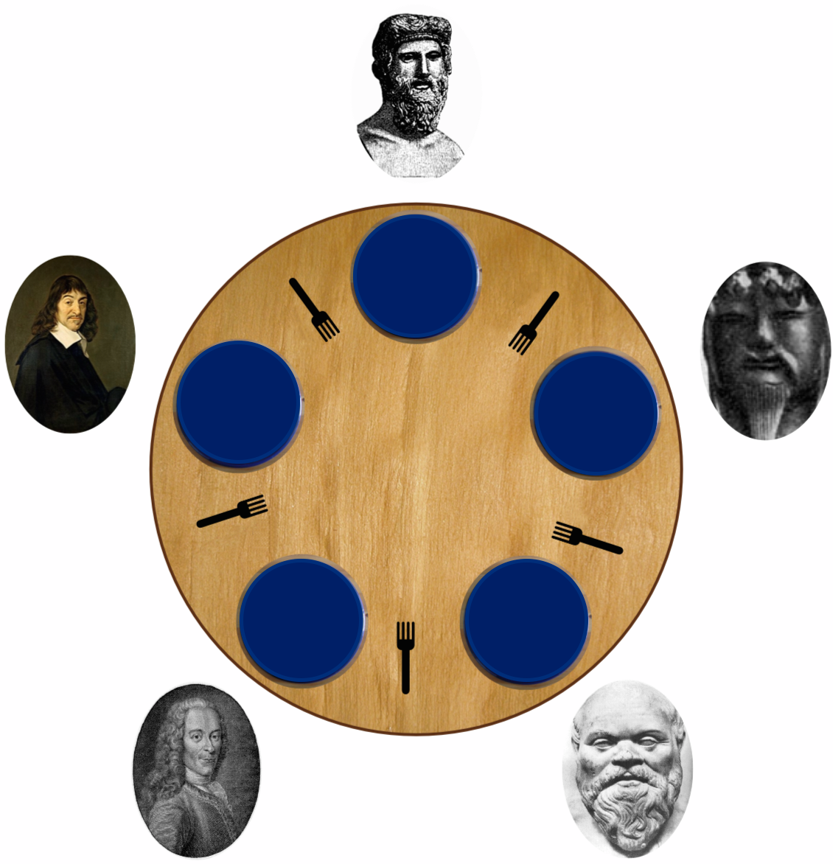
DINING Philosopher's PROBLEM
Every Philosopher needs two forks in order to eat.
Every Philosopher may pick up the forks on the left or right but only one fork at once.
Philosophers only eat when he had two forks.
Each fork is either clean or dirty.

Slide 4
1. Mutual Exclusion Principle. No two Philosophers can have the two forks Simultaneously. 2. Free from Deadlock Each Philosophers can get the chance to eat in certain finite time. 3. Free from Starvation. When few Philosophers are waiting then one get chance to eat in a while. 4. No strict Alternation 5. Proper utilization of time.
Correctness Properties it needs to satisfy are:

Slide 5
In 1984 , K. Mani Chandy and J. Mishra Proposed a solution for Dining Philosophers Problem to allow for some agents to contend for arbitrary number of Resources. It is completely Distributed and requires no central authority for initialization. However it violates the requirement that no two Philosophers can talk to each other. Here there is request message for fork sent by Philosophers in order to take fork.
Chandy / Mishra Solution:

Slide 6
- For each Pair of Philosophers contending for a resource, create a fork and give it to the philosophers with the lower id. Each fork can be either clean or dirty. Initially all the forks are dirty. - When a Philosopher want to use set of resources for eat Then in that case the Philosopher must want to obtain the fork from contending neighbours. For all such forks the Philosopher doesn’t have They sent a request message.
Chandy / Mishra Solution:

Slide 7
- When a Philosophers with a fork receives a request message, then keep the fork if it is clean, but give it up when it is dirty. If the philosopher sends the fork over, then clean the fork before doing so. - After a Philosopher is done eating, all the forks become dirty If another philosopher had previously requested one of the fork, the philosopher had just been finishes eating cleans the fork and sent it.
Chandy / Mishra Solution:

Slide 8
In their analysis they derive a system of preference from the distribution of the forks and their clean / dirty states. They show that this system may describe a directed a cyclic graph and if so, in their protocol cannot turn into a cyclic one. This guarantees that deadlock cannot occur. However, if the system is initialized to a perfectly symmetric state, like all philosophers holding their left side forks, then the graph is cyclic at the outset, and their solution cannot prevent a deadlock. Initializing the system so that philosophers with lower IDs have dirty forks ensure the graph is initially acyclic.
Chandy / Mishra Solution:

Slide 9
Chandy / Mishra Solution:
P1
This graph is acyclic so the graph made further are also acyclic as the changes in priority happens is accordingly in that fashion.
Suppose initially P1,P2,P3 have priority 0,1,2 as depicted form figure then as P1 complete its work the priority changes to 2,0,1 respectively and p2 start its job after P2 is done the priority becomes 1,2,0 and P3 start its job likewise the process go on..
P2
P3

Slide 10
Advantages of Chandy/ Mishra Solution: 1) Allows large degree of concurrency. 2) Free from Starvation. 3) Free from Deadlock. 4) More Flexible Solution. 5) Economical 6) Fairness 7) Boundedness.
Chandy / Mishra Solution:

Slide 11
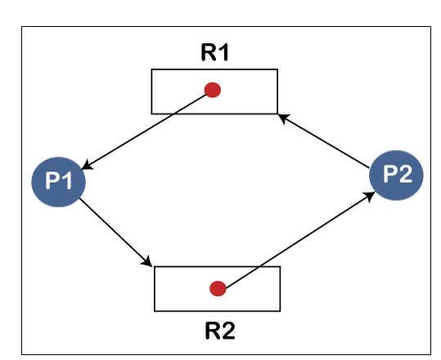
Deadlock is a situation where a set of processes are blocked because each process is holding a resource and waiting for another resource acquired by some other process. Lets elaborate it with an example:
Deadlock
Here, There are two resources R1, R2 both having single instance and two processes P1, P2
P1 have resource R1 and waiting for resource R2
which is held by P2 and P2 is waiting for resource R1 which is held by P1 so finally both doesn’t get resource and waiting infinitely and no one get completed.

Slide 12
In case of Single Instance Resource: - If Resource allocation graph contains circular wait means it have cycle in that case there will always be a deadlock. - If Resource allocation graph doesn't contain circular wait means it have no cycle in that case it is free from deadlock. In case of Multiple Instance Resource: - If resource allocation graph contains circular wait means it have cycle in that case there might be possibilities that it may have deadlock situation. - If resource allocation graph doesn’t contain circular wait means it have no cycle in that case there is no deadlock situation.
Deadlock

Slide 13
Conditions necessary to satisfy for deadlock to occur are: 1. Mutual Exclusion 2. No pre-emption 3. Hold and Wait 4. Circular Wait
Sufficient condition for Deadlock

Slide 14
1. Deadlock Ignorance (Ostrich Method) This method is used by various operating system like windows, Linux etc As cost for solution is high and it also effects the speed of the system and this deadlock situation is not frequently occurring situation so they choose to ignore deadlock instead making solution on that. 2. Deadlock Prevention In this the operating system tries to prevent deadlock to occur in order to do so operating system tries to break at least one condition from above in order to prevent processes form deadlock in case deadlock are going to be occur.
Various Methods To handle deadlock:

Slide 15
3. Deadlock Avoidance -Bankers Algorithm 4. Deadlock detection and Prevention In this if the operating system detects the deadlock condition in that case it start killing processes until the deadlock condition becomes false in some priority order so the degradation in performance minimizes.
Various Methods To handle deadlock:

Slide 16
The Banker’s Algorithm is a resource allocation and deadlock avoidance algorithm that tests for safety by simulating the allocation for predetermined maximum possible amounts of all resources, then makes check to test for possible activities, before deciding whether allocation should be allowed to continue or not. This algorithm is named as Bankers algorithm because this technique is wildly used in Banking system for loan saction activities.
Bankers Algorithm

Slide 17
When working with the Bankers Algorithm, The three need to be know.. 1) How much each process can request for each resource in the system. It is denoted by the [MAX] request. 2) How much each process is currently holding each resource in a system. It is denoted by the [ALLOCATED] resource. 3) It represents the number of each resource currently available in the system. It is denoted by the [AVAILABLE] resource.
Bankers algorithm

Slide 18
It is a safety algorithm used to check whether or not a system is in a safe state or follows the safe sequence in a Banker’s Algorithm: 1. There are two vectors work and finish of length m and n in a safety algorithm. Initialize: Work = Available. 2. Check the availability status for each type of resource [i], such as: Need[i] <= Work Finish[i] == false If the I doesn't exist, go to step 4. 3.Work = Work + Allocation // to get new resource allocation Finish[i] = true. Go to step 2 to check the status of resource availability for the next process. 4. If Finish[i] == true; it means that the system is safe for all processes.
SAFETY algorithm

Slide 19
A resource request algorithm checks how a system behaves when a process makes each type of resource request as a request matrix. Lets create a resource request array R[i] for each process P[i]. If the Resource Request_{i} [j] equals to ‘K’, which means the Process P[i] requires ‘k’ instances of Resources type R[j] in the system. 1. When the number of requested resources of each type is less than the Need resources go to step 2 and if the condition fails, which means that the process P[i] exceeds its maximum claim for the resource, As the expression is If Request[i] <= Need Go to step 2
Resource Request Algorithm

Slide 20
2. And when the number of requested resources of each type is less than the available resource for each process, go to step[3], According to expression If Request[i] <= Available Else Process[i] must wait for the resource is allocated to the process by changing state. 3. When the requested resource is allocated to the process by changing state: Available = Available – Request Allocation[i] = Allocation[i] + Request[i] Need (i) = Need (i) – Request (i) When the resource allocation state is safe, its resource are allocated to the process P(i), And if the new state is unsafe, The process P[i] has to wait for each type of Request(i) and restore the old resource- allocation state.
Resource Request Algorithm

Slide 21
Let there are n number of processes and they need at max m number of resources at all having some instances of their own: - we had given the allocation of these resources and the maximum need for each resources they required for each process in order to do their job done. We had to find out is there deadlock or not … If there is no deadlock then in which sequence the process should be organised. The process for same is explained in next slide.
BANKERS ALGORITHM

Slide 22
Step 1: Find the total allocated resources instance for different resources in all processes. Step 2: Then find the available resources instance for each resource. Step 3: Find the remaining need of each resource instance for each process. Remaining need = Max need – Allocation Step 4: Check there is any process for which Remaining need <= Available Step 5: Free the resources kept by that process and change the availability of the resources according if any.. Step 6: If there is still process remaining go to step 4 or if there is no such process for which Remaining need <= Available condition satisfies then in that case say there is deadlock. or there is no process remain print the sequence in which the process got finished and say no deadlock.
BANKERS ALGORITHM

Slide 23
Problem: Considering a system with five processes P0 through P4 and three resources of type A,B and C. Resource type A has 10 instances , B has 5 instances and type C has 7 instances. Suppose at time t0 following is the details of the system has been taken.
Bankers algorithm
Process | Allocation A | Allocation B | Allocation C | Maximum A | Maximum B | Maximum C
P0 | 0 | 1 | 0 | 7 | 5 | 3
P1 | 2 | 0 | 0 | 3 | 2 | 2
P2 | 3 | 0 | 2 | 9 | 0 | 2
P3 | 2 | 1 | 1 | 2 | 2 | 2
P4 | 0 | 0 | 2 | 4 | 3 | 3

Slide 24
Step 1: Total allocated resources Allocation A = 0 + 2 + 3 + 2 + 0 = 7 Allocation B = 1 + 0 + 0 + 1 + 0 = 2 Allocation C = 0 + 0 + 2 + 1 + 2 = 5 Step 2: Available Instance of each resources Available A = Total A instance – Allocated A instance = 10 – 7 = 3 Available B = Total B instance – Allocated B instance = 5 – 2 = 3 Available C = Total C instance – Allocated C instance = 7 – 5 = 2
Bankers algorithm

Slide 25
Step 3: Remaining needs for each processes Formula: Remaining needs = Max instance need - Allocated instance Here remaining is shown as rest in table.
Bankers algorithm
Process | Allo. A | Allo. B | Allo. C | Max A | Max B | Max C | Rest A | Rest B | Rest C
P0 | 0 | 1 | 0 | 7 | 5 | 3 | 7 | 4 | 3
P1 | 2 | 0 | 0 | 3 | 2 | 2 | 1 | 2 | 2
P2 | 3 | 0 | 2 | 9 | 0 | 2 | 6 | 0 | 0
P3 | 2 | 1 | 1 | 2 | 2 | 2 | 2 | 1 | 1
P4 | 0 | 0 | 2 | 4 | 3 | 3 | 5 | 3 | 1

Slide 26
Now for step 4 and step 5: condition: Remaining need <= Available For P0 : Resource B instance is not fulfilling As P1 is satisfying that condition so it runs and drop its resources now availability is A = 3 + 2 = 5 , B = 3 , C = 2 After that P2 doesn’t satisfy the above condition and P3 satisfies above condition to it runs and drop its resources now availability is A =5 + 2 = 7 , B = 3 + 1 = 4 , C = 2 + 1 = 3
Bankers algorithm

Slide 27
Now P4 satisfies the above condition so it gets executed and leave its resources. Now availability is A = 7 , B = 4 , C = 3 + 2 = 5 Now again we come to top and check for P0 this time P0 satisfies the above condition so it runs and then drop its resources and now the availability is A = 7 , B = 4 + 1 = 5, C = 5 At last now check this for left process that is P2 this time P2 also satisfies the above condition and it get resources then it run and then leave the resources Now availability of resources becomes A = 7 + 3 = 10 , B = 5 , C = 5 + 2 =7 Here we can observe that all the resources are free when all process executed.
Bankers algorithm

Slide 28
The sequence for above in which the process got executed is P1 → P3 → P4 → P0 → P2 If in above problem, In case if we stuck in some process which don’t satisfy the condition In that case we declare that here is the deadlock and now rest processes cant be executed as the resources they needed won’t be get to them in order to execute themselves.
Bankers algorithm

Slide 29
It contains various resources that meet the requirements of each process. 2. Each process should provide information to the operating system for upcoming resource requests, the number of resources, and how long the resources will be held. 3.It helps the operating system manage and control process requests for each process requests for each type of resource in the computer system. 4.The algorithm has a Max resource attribute that represents each process can hold the maximum number of resources in a system.
ADVANTAGES OF Bankers algorithm

Slide 30
It requires a fixed number of processes, and no additional processes can be started in the system while executing the process. 2. The algorithm does no longer allows the processes to exchange the maximum needs while processing its tasks. 3. Each process has to know and state their maximum resource requirement in advance for the system. 4. The number of resource requests can be granted in a finite time, but the time limit for allocating the resource is one year.
Disadvantages of Bankers algorithm

Slide 31
THANKS

